Slide 1

Madhusudhan V (Madhu)
>Karnataka, India
>Computer Science Engineering Graduate
13+ years of experience in Different technologies
>Domains: Medical, Retail, Insurance, and Wealth management.
>Country: USA, Canada, Switzerland, UK, Australia, Europe, Africa
>Companies: Wipro, TCS, Cap Gemini, Dxc, Hp, Adlib...
>Mostly Using Microsoft technologies like web, cloud, azure

Slide 2
Inspiration
>Born & Grown village=>small town=>towns=>city...
>Technology rapid growth
>Everybody has advanced Gadgets like iPhone & More with 4G,5G
>But Not Utilizing & Connected Properly even for emergency

Slide 3
Research & Analysis
>Rather keeping quiet
>Since 6-7 year, Analyzing real time Cases & Planning across country
>In last 2 year, did few Projects but Not Success But learnt

Slide 4
Other Innovative Projects
Next-Mp.in
Hennu.in
UnWell.in
Before choosing Next Member of parliament lets collect the current quality and issues at one place using metrics.
A dedicated platform focused on girl and women's safety and empowerment, leveraging technology to create a safer environment.
Making health and medicines more affordable and accessible for everyone, with a non-commercial approach.

Slide 5
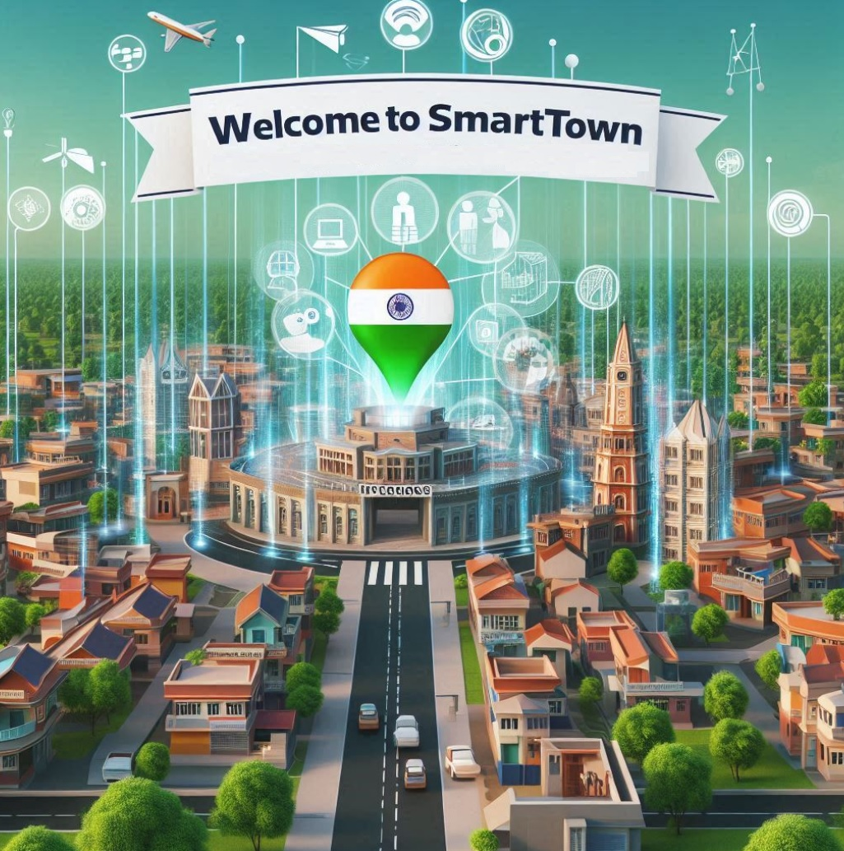
Sand Boxed Centralized Authenticated Solution of Any Town
School, College
Doctor, Hospital
Real Estate Buy or Sale
Hotel or Lodging
Emergency info
Bank, Government News
Town updates
Sports, Events
Lost or Found
Jobs , Open/Seeking

Slide 6
Problem Examples (In My Town?)
>which all orthopedic doctors available & what time
>School/college how to share news like Admissions open, tomorrow
>Government, Political Events and News
>Small Gifts shop cant advertise over fb/google as non affordable . How to advertise

Slide 7
Solution: SmartTown
>15-20$ => 1$
>Centralized
>Continuation with existing Fb, Youtube,Google business,Oyo and continuation
>Easy & Live updates
>No Hidden Charges... Complete Transparent pricing
>Simple dedicated software for everyone
>AI-Analysis using AI of Enquiry,feedbacks all
>MVP1 by September
>V1

Slide 8

Katthe Technologies Empowering ‘Local’ Communities, Talents & Resources
Madhusudhan V

Slide 9

Our Office & Team
Our registered office is located in the vibrant city of Bhadravathi, Karnataka, India.
Mostly all remotely connected, based on need will make more offices across the globe.
Madhusudhan V
Architect, with extensive experience in international key projects and a passion for community-driven solutions.
Global Contributors
Namitha K
Manjushree V Veerabhadrappa R … more adding Gradually
We connect with a network of global contributors and freelancers to bring diverse perspectives and expertise to our projects.
Non-Technical Contributions
We welcome contributions from a wide range of individuals, including housewives, handicaps, retired experts, students, and government employees.

Slide 10
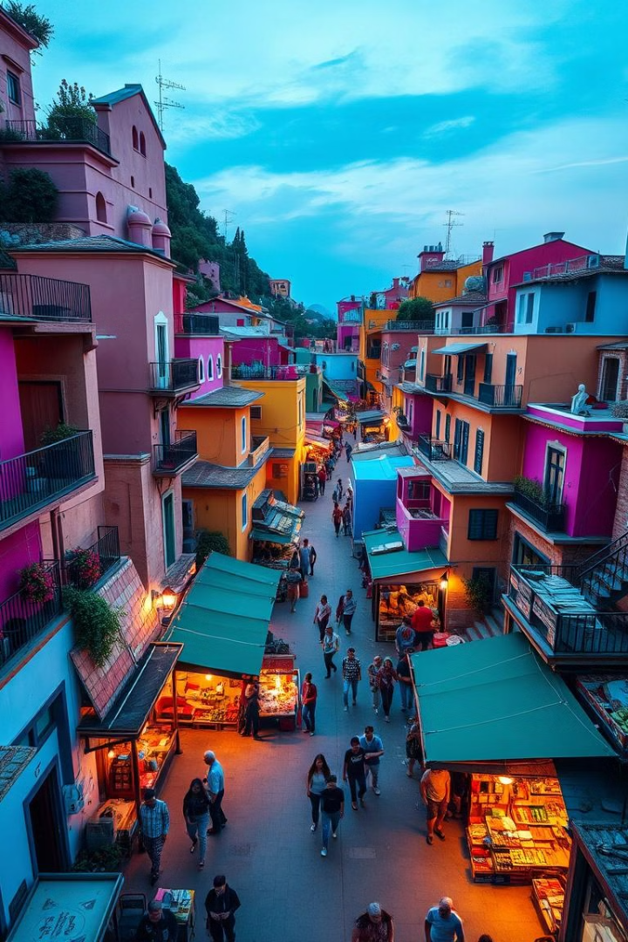
Introducing SmartTown: Connecting Your Local Community
Centralized, Town-specific Platform
Power Of Information And Connectivity Right
At Hands Of Residents And Local Businesses.
Discover What's Happening,
Get The Details You Need
Stay Informed About Your Community.

Slide 11
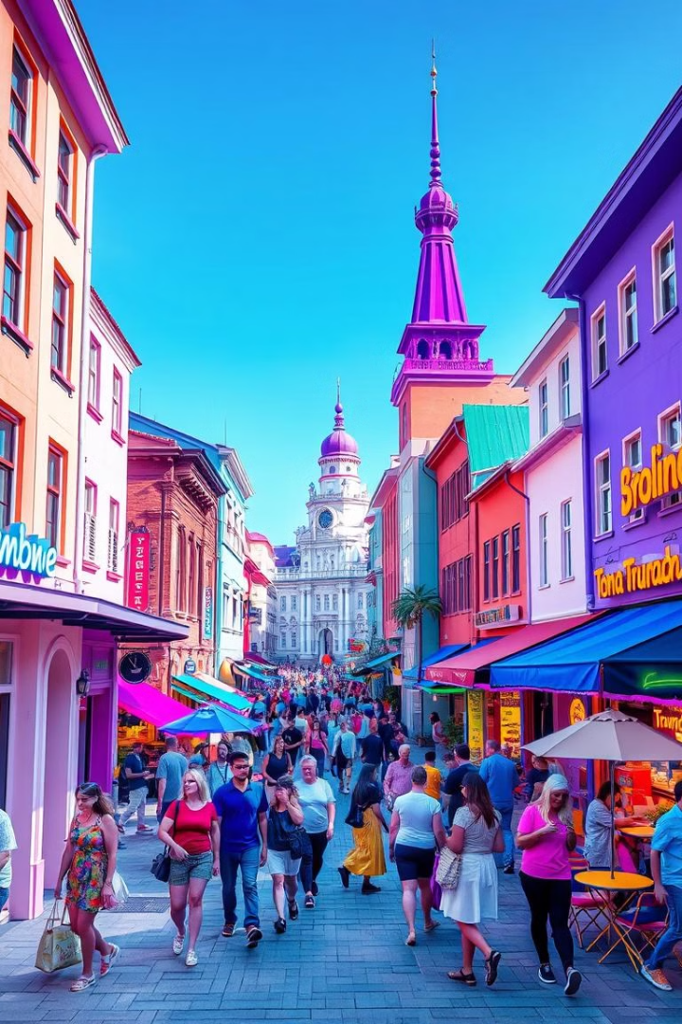
Addressing the Information Gap
1
Missing Information
2
Lack of Connectivity
Residents often struggle to find reliable, up-to-date information about local businesses, services, and events.
Small businesses have limited options to effectively reach and connect with their local customer base.
3
Decentralized Data
Information is scattered across multiple platforms, making it difficult for both residents and businesses to access.

Slide 12
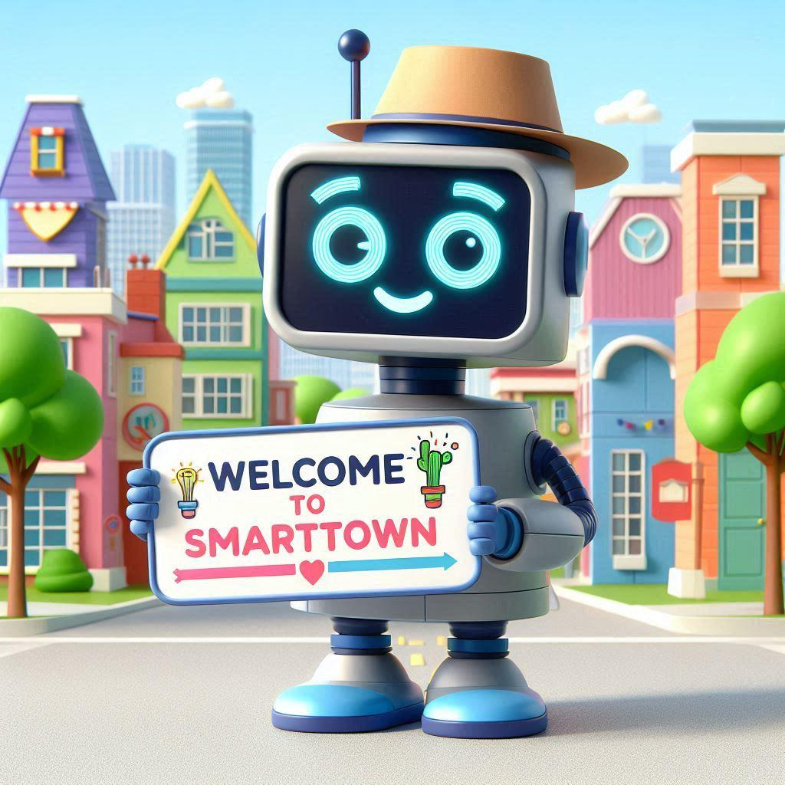
SmartTown: Your Town's Digital Hub
Centralized Data
Empowering Businesses
Informed Residents
SmartTown aggregates and organizes all the essential information about your town in one user-friendly platform.
Local businesses can easily create and manage their online profiles, share updates, and connect with customers.
Residents can access real-time information about businesses, events, and community news with just a few taps.

Slide 13





Connecting Businesses and Customers
Business Profiles
Events & Promotions
Customer Reviews
Direct Communication
Businesses can create detailed profiles to showcase their offerings, hours, and contact information.
Businesses can easily share their upcoming events, sales, and special offers with the local community.
Customers can leave reviews and ratings to help others make informed decisions about local businesses.
Customers can directly contact businesses through the platform, fostering better customer-business relationships.

Slide 14
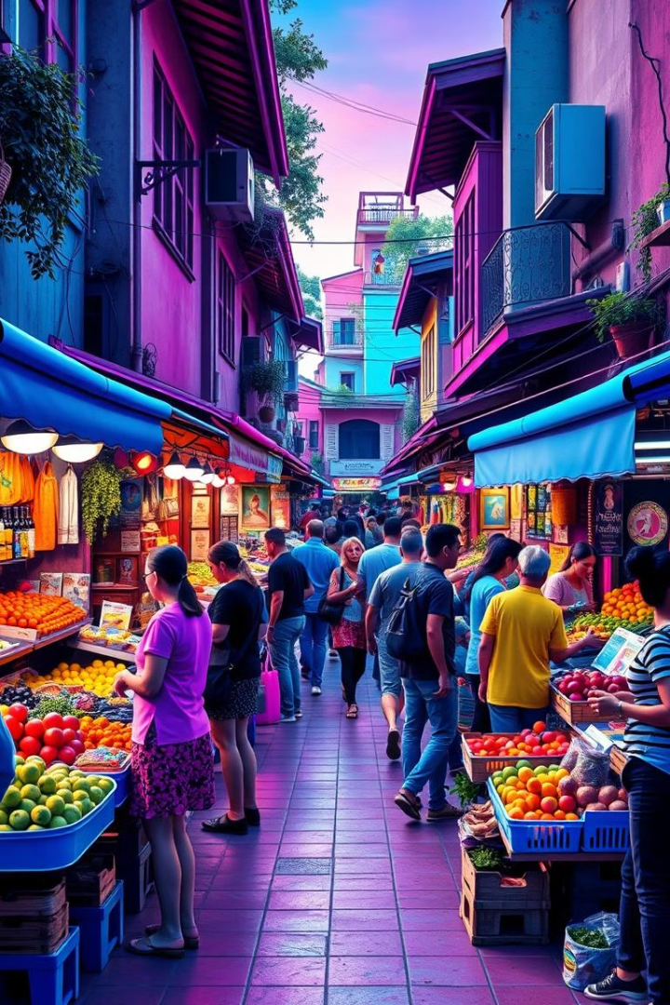
Empowering Local Economies
1
Increased Visibility
SmartTown helps local businesses reach a wider audience and gain more visibility within their community.
2
Fostering Connections
The platform facilitates connections between businesses and customers, leading to more engaged local communities.
3
Supporting Growth
By providing affordable and effective marketing tools, SmartTown enables small businesses to thrive and expand.

Slide 15
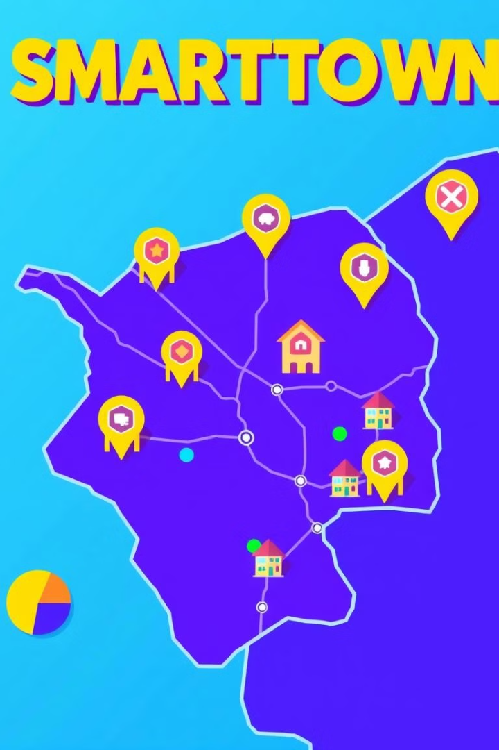



Expanding Reach, One Town at a Time
Scalable Model
SmartTown's modular design allows for easy replication and deployment in new towns, creating a network of connected communities.
Customizable Branding
Each SmartTown instance can be tailored to the unique identity and needs of the local community, ensuring a seamless user experience.
Collaborative Growth
SmartTown encourages peer-to-peer validation and community engagement, fostering a shared sense of ownership and pride.

Slide 16
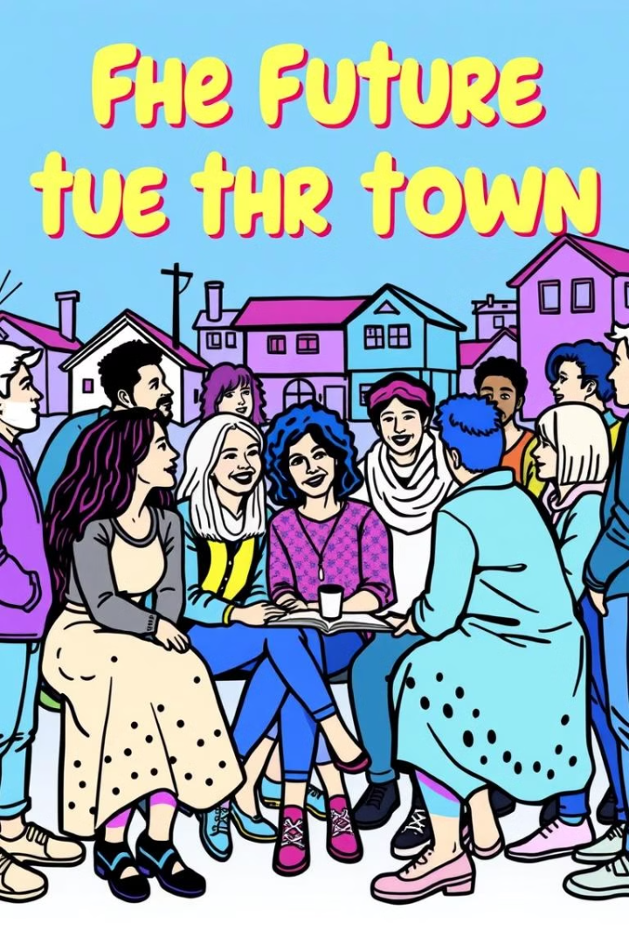
Your Town, Your Voice
Resident Feedback
Streamlined Communication
Collaborative Decision-Making
SmartTown provides an easy platform for residents to share their ideas, concerns, and feedback about their town.
The platform facilitates transparent and efficient communication between local authorities, businesses, and the community.
SmartTown empowers residents to actively participate in shaping the future of their town through collaborative initiatives and decision-making processes.

Slide 17

Join the SmartTown Revolution
1
Become a Partner
2
Spread the Word
3
Stay Involved
Collaborate with us to bring the power of SmartTown to your community and help shape the future of local connectivity.
Share the vision of SmartTown with your friends, neighbors, and local businesses, and help us build a network of thriving, connected towns.
Provide feedback, suggestions, and ideas to help us continuously improve the SmartTown platform and better serve the needs of your community.

Slide 18

The Future of Local Communities
SmartTown is not just a platform – it's a vision for the future of local communities. By empowering residents and businesses with the tools they need to connect, collaborate, and thrive, we're building a network of towns that are more transparent, engaged, and prosperous than ever before.

